Slide 1
Spam Detection Using Naive Bayes
OM M. PATEL 21BCP094

Slide 2
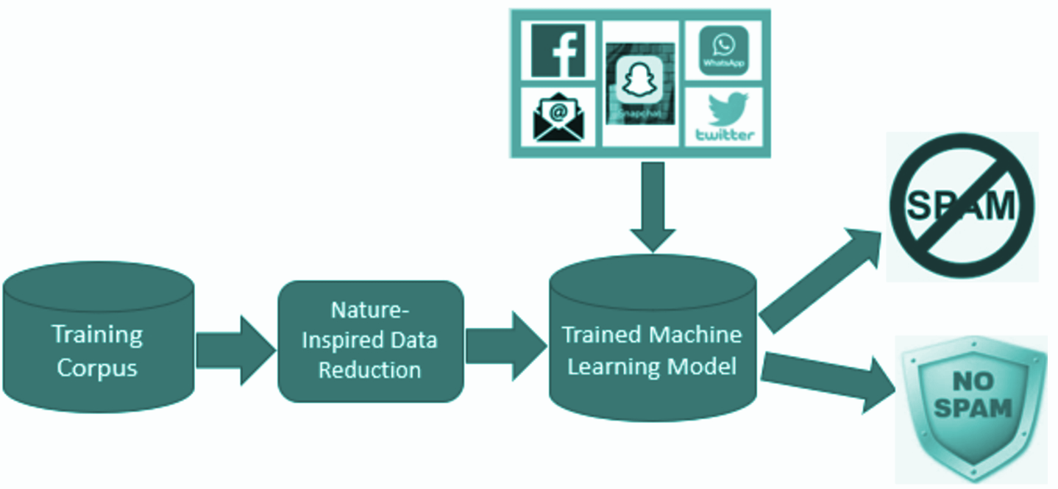
Problem Statement
What is Spam Detection?
Spam detection identifies unwanted or harmful messages in text-based communication.
Essential for reducing unwanted content in emails, SMS, and social media.
Objective
Build a model to classify messages as either "spam" (unwanted content) or "ham" (legitimate content).
Develop a custom Naive Bayes Classifier in Java for classifying text messages effectively.

Slide 3
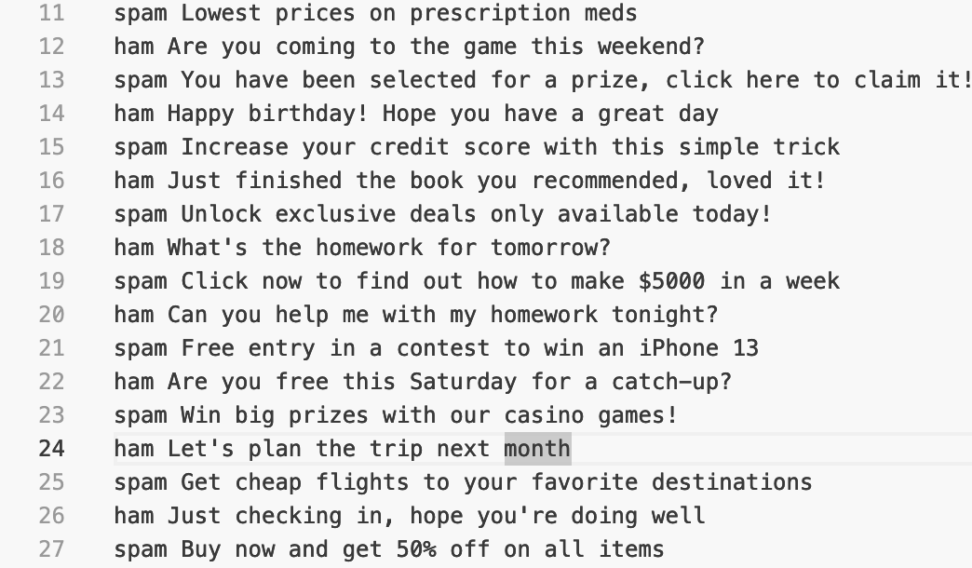
Dataset
Source: Sample labeled dataset extracted from Web and with help of Artificial intelligence tools.
Format: Each line includes a message with a "spam" or "ham" label.
Example Messages:
spam Win a free vacation to Hawaii now
ham Hey, are we still on for dinner tonight?
Challenges with Dataset:
Limited diversity may impact generalizability.
Class imbalance (often more ham than spam), which could bias the classifier.

Slide 4
Methodology Overview
1. Data Preprocessing: Cleaning and tokenizing text to create a structured dataset for the model.
2. Model Selection: Using Naive Bayes, a probabilistic algorithm effective for text classification.
3. Training & Testing:
Training: Learning word probabilities from labeled data.
Testing: Validating on predefined messages and interactive user inputs.
4. Evaluation: Manually verifying classification accuracy using sample and user-provided messages.
Data Preparation
Data Preprocessing
Learning Phase
Text Classification
Evaluation

Slide 5
Code Structure
DataReader.java: Reads the messages.txt file and parses messages into labeled Message objects.
Example: spam Buy now and get 50% off!
Message.java: Represents a message with its label (spam or ham) and text.
TextProcessor.java: Preprocesses text by tokenizing, converting to lowercase, and removing punctuation.
Key Function: processText(String text) which standardizes text for training.
NaiveBayesClassifier.java: Core classifier implementing the Naive Bayes algorithm.
Functions:
train(List<Message> data): Calculates word probabilities based on message labels.
classify(String message): Predicts the label for a new message by calculating probabilities.

Slide 6
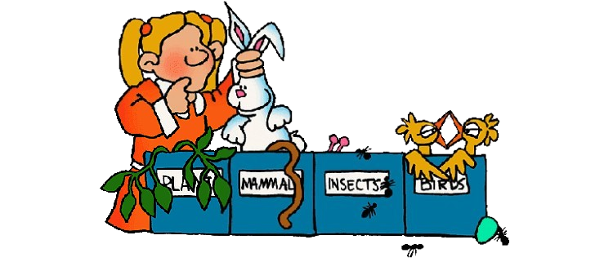
Naive Bayes Classifier
Bayesian Approach:
Calculates the probability that a message belongs to either "spam" or "ham" based on word occurrences.
Steps:
Tokenize each message to get individual words.
Calculate word frequencies for each class (spam and ham).
Apply Bayes' theorem: Use calculated word probabilities to classify new messages.
Why Naive Bayes?
Simple, effective, and interpretable for text data.
Performs well in high-dimensional spaces typical of text data.

Slide 7
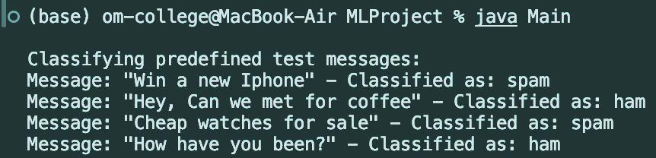
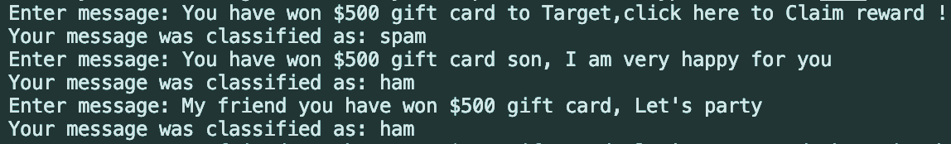
Results
Test Messages:
Sample results from predefined test messages.
Example classifications:
User Interaction:
Accuracy Observations: High accuracy for messages with spam-like keywords

Slide 8
Insights And Key Takeaways
Effective Word Indicators:
Words like "win," "free," and "click" have high spam association.
Model Efficiency:
Naive Bayes is fast and interpretable for small text datasets.
Good accuracy achieved with limited data but may need more data for diverse scenarios.

Slide 9
Challenges and Solutions
Data Limitations:
Solution: Larger dataset or more varied examples would improve robustness.
User Input Handling:
Solution: Ensured smooth input handling with Java Scanner for console-based user interactions.
Class Imbalance:
Solution: Can adjust for this by weighting classes or using more data to balance labels.

Slide 10
Future Work
Model Improvement:
Experiment with more sophisticated NLP techniques like TF-IDF and word embeddings.
Expanded Dataset:
Integrate larger datasets to improve generalizability.
Real-World Application:
Potential to integrate with messaging platforms for real-time spam detection.

Slide 11
THE END

